Slide 1


The Fine Tuners
24.10.2023

Slide 2
Table of Content
About Us
01
Meet the Team
Our Mission, Approach and Goal
Our Ceremonies
02
Our Tools
EDA
03
04
Open Questions
Thank you
05

Slide 3



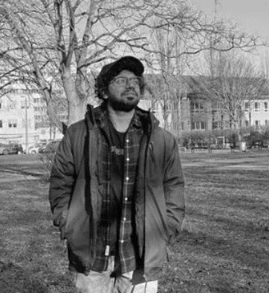
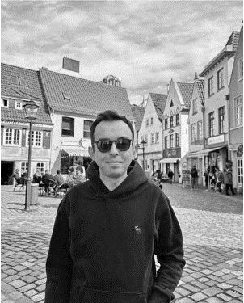
Meet the Team
Erjon Buka
Product Owner
Ecem Günhar Akuras
Scrum Master
Shinu Joseph
Developer
Akshay Rajesh
Developer
M.Cem Akuras
Developer

Slide 4
Our Mission, Approach and Goal
As a consulting company, we'll employ advanced NLP techniques - classification, model training, and prompt engineering - to autonomously generate actionable maintenance recommendations from tweet data. Our focus will be on component identification and label noise mitigation.
Our Mission
Our Goal
Our objective is to develop 'Tweets2GPT', a robust system providing precise, real-time maintenance guidance based on social media data. This will lead to a revolution in operations at Thameslink, driven by our consultancy services.
Our mission is to utilize NLP, including text classification and summarization, combined with GPT model expertise, to analyze social media tweets and GPS data.
Our Approach

Slide 5
Our Ceremonies
Daily Standups | Sprint Review (Internal) | Sprint Review (External) | Sprint Retrospective | Sprint Planning
Short daily meetings Team members' updates: What they did yesterday Plans for today Blockers they're facing Frequency: Daily Duration: 15-20 min | End-of-sprint meetings Team presents completed work Receives feedback Focuses on sprint accomplishments Frequency: Weekly (Mondays) Duration: 1h | Team presentation on CRISP-DM progress Discussion and feedback from stakeholders Frequency: Biweekly (Tuesdays) Duration: 15 min presentation and Q&A, 20 min review | Team reflection on past sprint Discussion of what went well Identification of areas for improvement Planning for improvements in the next sprint Frequency: Weekly Duration: 30 min | Start-of-sprint meeting Team decides work for the sprint Selection from the product backlog Commitment to completing chosen items Frequency: Weekly Duration: 1h

Slide 6




Our Tools
Code Editor
Visual Studio Code
Jupyter Notebook
Github
Version Control, Collaboration
Project Management, Collaboration
Clickup
Future Tools
Label Studio, Dash, Flask, SQLite, ChatGPT API

Slide 7
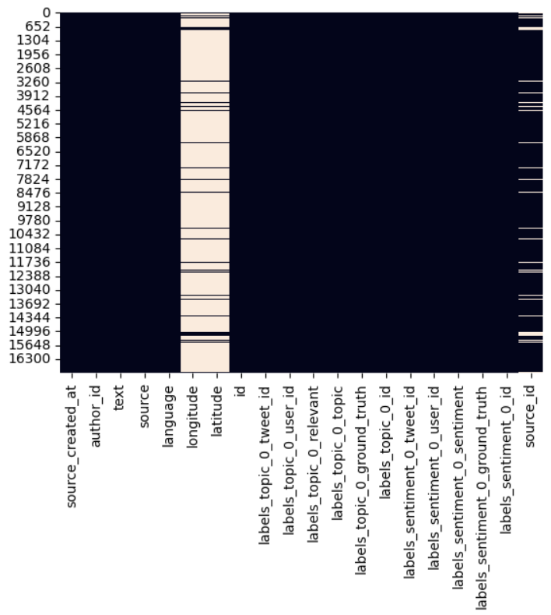
EDA
JSON file
Totally 20 columns
Totally 16949 Lines
3 columns have missing values

Slide 8
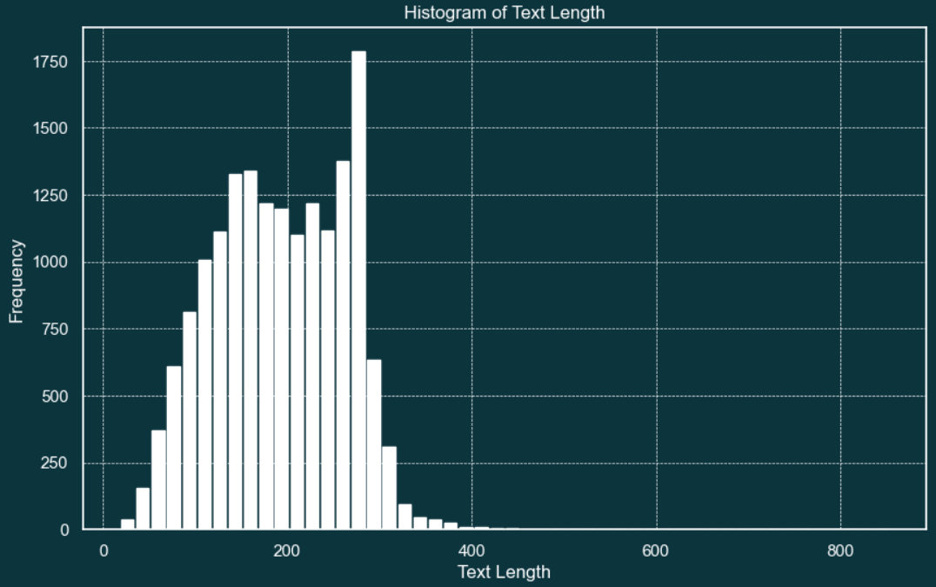
EDA
Length of tweets are controlled to tailor NLP models for accurate classification and recommendation tasks using social media data.

Slide 9
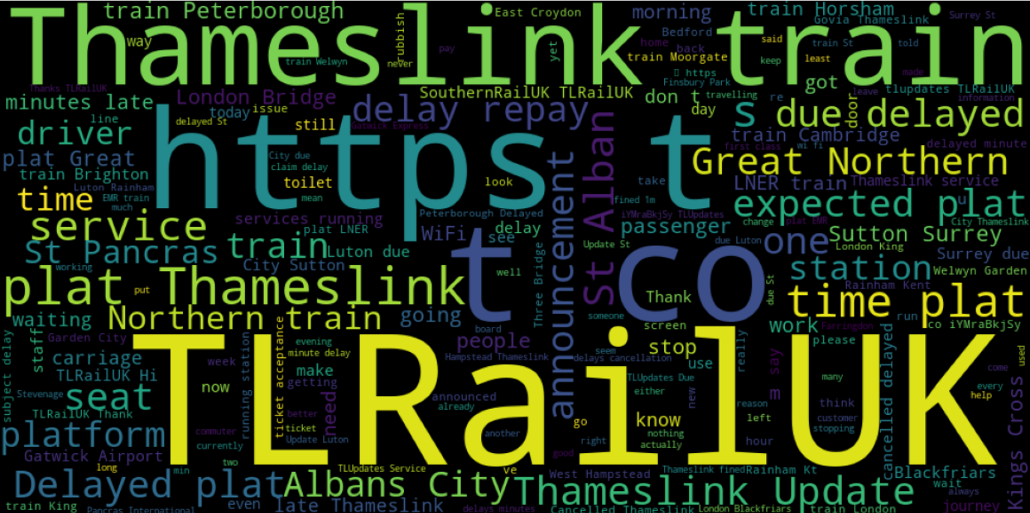
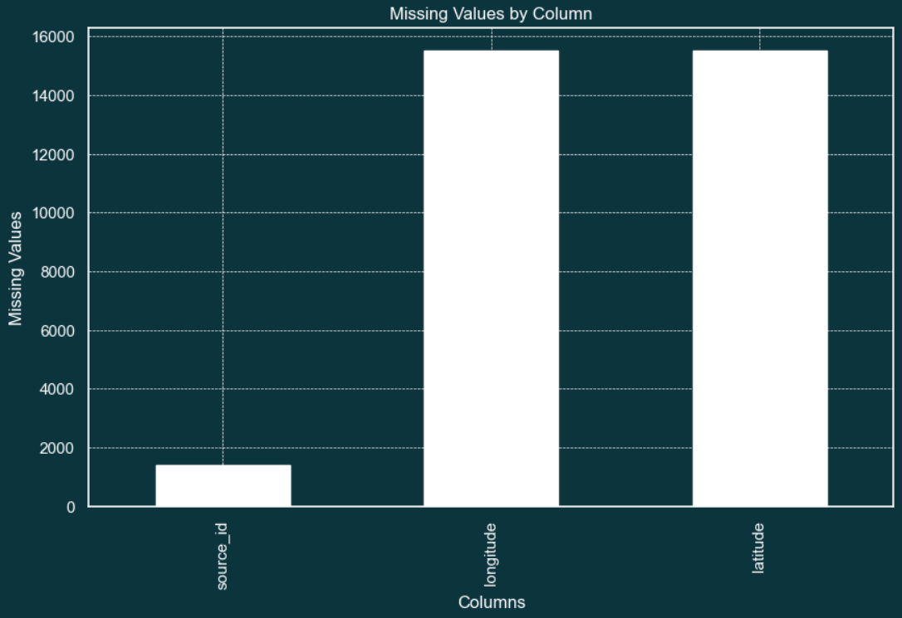
EDA
The most frequently used words were checked to ensure that unusual or unexpectedly frequently used words did not cause problems during data collection or preprocessing.
Longitude and Latitude columns are not able to be used, where we cannot gain any finding from GPS values.

Slide 10
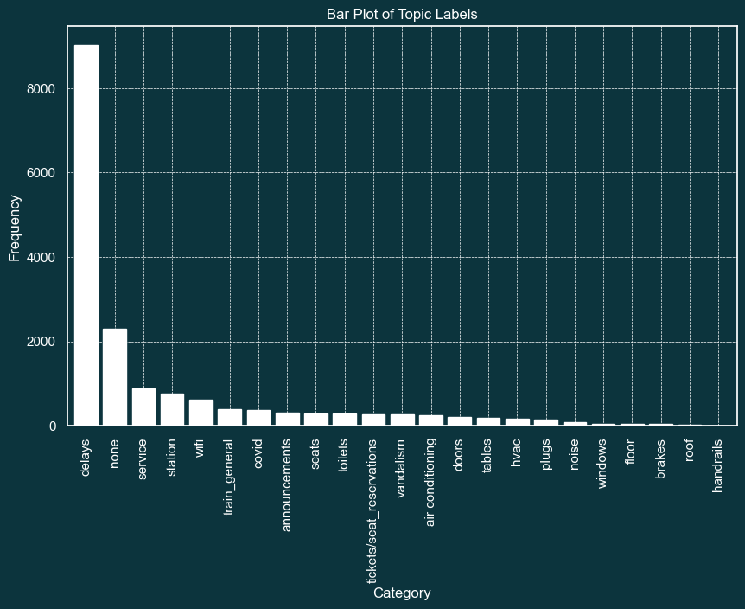
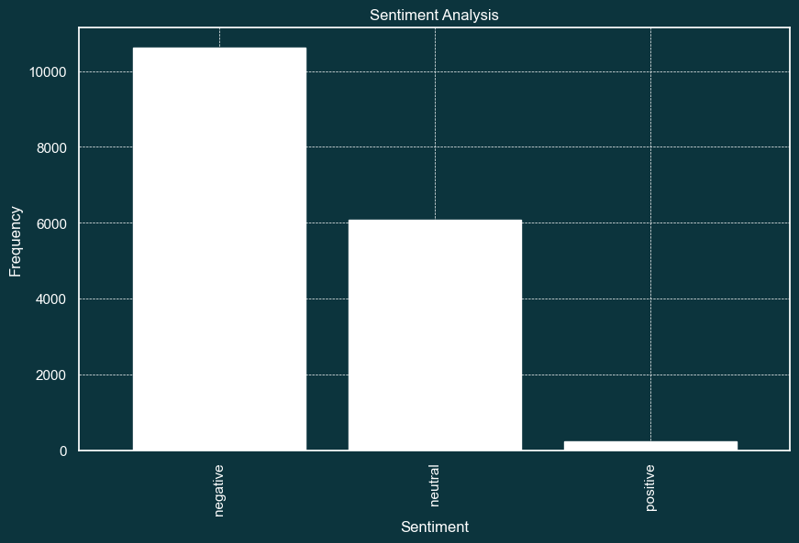
EDA
Topic column helps us to categorise problem by the tweet.
Analyzing sentiment in tweets allows to gauge customer sentiment towards Thameslink's maintenance services.

Slide 11
Open Questions
What is the structure of future data? I assume unprocessed tweets extracted from api
Can you give us a sample of the sample output you are looking for?
What is the success definition?

Slide 12
Thank you!

